Slide 1
Approaching God in Prayer
Sunday Service 18 Feb 2018
Cecil Ang

Slide 2
Luke - the gospel of prayer
Jesus’ baptism (3:21)
Before the call of the 12 (6:12-13)
Before Peter’s confession (9:18)
At Christ’s transfiguration (9:28-29)
In the Garden of Gethsemane (22:41-42)
At Christ’s crucifixion (23:34,46)
Parables of unrighteous judge (18:2-8); Pharisee and the publican (18:10-14)

Slide 3
Engaging in Spiritual Warfare
“Simon, Simon, behold, Satan demanded to have you, that he might sift you like wheat, but I have prayed for you that your faith may not fail. And when you have turned again, strengthen your brothers.” Lk 22:31-32 ESV

Slide 4
Message Outline (based on Luke 11)
Pattern for Prayer (v 1-4)
Parable on Prayer (v 5-8)
Principles of Prayer (v 9-13)
Personal Commitment to Prayer

Slide 5
1. Pattern for Prayer
Now Jesus was praying in a certain place, and when he finished, one of his disciples said to him, “Lord, teach us to pray, as John taught his disciples.” ² And he said to them, “When you pray, say:“Father, hallowed be your name. Your kingdom come. ³ Give us each day our daily bread, ⁴ and forgive us our sins, for we ourselves forgive everyone who is indebted to us. And lead us not into temptation.” Luke 11:1-4 ESV

Slide 6
1. Pattern for Prayer
“Father” – the privilege of calling God as Abba/Daddy
“Hallowed be your name” – you are holy
How majestic is your name in all the earth! You have set your glory above the heavens (Ps 8:1 ESV)
Worthy are you, our Lord and God, to receive glory and honor and power (Rev 4:11 ESV)

Slide 7
1. Pattern for Prayer
“Your kingdom come” – praying for God’s rule & reign to be on earth
I pray that the eyes of your heart may be enlightened to see the light of the gospel of the glory of Christ (Eph 1:18; 2 Cor 4:4 NASB) [pre-believers]
Set them apart for Your purposes, make them holy by Your word (Jn 17:17 AMP) [believers]

Slide 8
1. Pattern for Prayer
“Your kingdom come” – praying for God’s rule & reign to be on earth
Heal me, O Lord, and I shall be healed; save me, and I shall be saved (Jer 17:14 ESV)
Come, Lord Jesus! (Rev 22:20b ESV)

Slide 9
1. Pattern for Prayer
“Give us each day our daily bread” – praying for our daily needs
Supply every need of mine according to your riches in glory in Christ Jesus (Phil 4:19 ESV)

Slide 10
1. Pattern for Prayer
“Forgive us our sins, for we ourselves forgive everyone who is indebted to us”
I confess my sins; I am deeply sorry for what I have done (Ps 38:18 NLT)
I forgive those who sin against me (NLT)

Slide 11
1. Pattern for Prayer
“Lead us not into temptation” – let us not sin / fall when tempted
Keep and protect them from the evil one (Jn 17:15 AMP)
Lead me in paths of righteousness for your name sake and counsel me with your eye on me (Ps 23:3; 32:8 ESV)

Slide 12
2. Parable on Prayer
⁵ And he said to them, “Which of you who has a friend will go to him at midnight and say to him, ‘Friend, lend me three loaves, ⁶ for a friend of mine has arrived on a journey, and I have nothing to set before him’; ⁷ and he will answer from within, ‘Do not bother me; the door is now shut, and my children are with me in bed. I cannot get up and give you anything’ ⁸ I tell you, though he will not get up and give him anything because he is his friend, yet because of his impudence he will rise and give him whatever he needs. Luke 11:5-8 ESV

Slide 13
2. Parable on Prayer
Impudence : anaideia (Gk) shamelessness or lack of modesty
⁶ And the Lord said, “Hear what the unrighteous judge says.⁷ And will not God give justice to his elect,who cry to him day and night? Will he delay long over them? ⁸ I tell you, he will give justice to them speedily. Nevertheless, when the Son of Man comes,will he find faith on earth?” Luke 18:6-8 ESV

Slide 14
3. Principles of Prayer
⁹ And I tell you, ask, and it will be given to you; seek, and you will find; knock, and it will be opened to you. ¹⁰ For everyone who asks receives, and the one who seeks finds, and to the one who knocks it will be opened. ¹¹ What father among you, if his son asks for a fish, will instead of a fish give him a serpent; ¹² or if he asks for an egg, will give him a scorpion? ¹³ If you then, who are evil, know how to give good gifts to your children, how much more will the heavenly Father give the Holy Spirit to those who ask him!” Lk 11:9-13 ESV

Slide 15
3. Principles of Prayer
Cultivate a vital, living relationship with God
If you abide in me, and my words abide in you, ask whatever you wish, and it will be done for you. Jn 15:7 ESV
God answers prayers for Jesus’ sake
Until now you have asked nothing in my name. Ask, and you will receive, that your joy may be full. Jn 16:24 ESV

Slide 16
God of the how much more
We can ask God for the best, a Person and not a thing. The Holy Spirit brings with Him both power (gifts), love (fruit) and intercession (Rom 8:26).
He who did not spare his own Son but gave him up for us all, how will he not also with him graciously give us all things? Rom 8:32 ESV
Let us therefore come boldly to the throne of grace that we may obtain mercy and find grace to help in time of need. Heb 4:16 NKJV

Slide 17
Praying through the 10/40 window

Slide 18
Prayer Movement
"The Holy Spirit is orchestrating a global prayer strategy in these very days. It will far eclipse any other prayer movement in Church history.The Holy Spirit is equipping the Church to partner with Jesus' intercessory prayer ministry at the right hand of the Father. The end result is the great harvest of souls being added to the Kingdom of God. The number of people coming to Jesus at the present hour across the nations is unprecedented in history. I believe this will continue to increase numeri- cally and in both power and intensity." - Mike Bickle

Slide 19
Let us SPLICE in prayer
Singapore (1 Tim 2:1-2)
Pre-believers/Prodigals (Mt 9:37-38)
Leaders in church (Heb 13:7)
Israel (Ps 122:6)
Church (Col 1:9-12)
Evangelism/Employment (Col 4:3; 1 Tim 3:7)

Slide 20
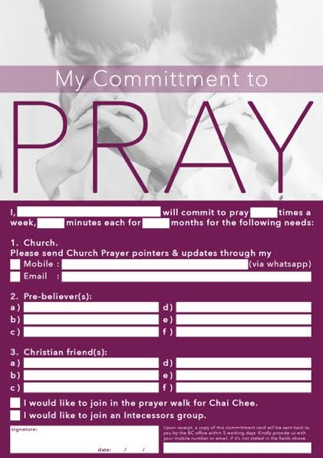
4. Personal Commitment to Prayer
Set aside time to pray
Adoration, Confession, Thanks-giving, Supplication
Pray simply & sincerely
Keep on asking, seeking & knocking
Pray expectantly
Pray with others e.g. P&P, Oikos

